Slide 1
FMT Model Performance Measures, ML Pipeline and Hyperparameter Tuning (Week 2)

Slide 2
Topics covered
Performance measures
ROC-AUC
Concept of Pipeline
Building a Pipeline
Performance on train vs test data
Hyperparameter tuning
Grid Search and Random Search
Hands-on Exercises

Slide 3
Session Agenda
Quick recap of classification metrics
Use of AUC and ROC
Use of a pipeline object
The Train, Validation and Test sets
Hyperparameter tuning – GridSearchCV and RandomSearchCV
Case Study
Questions

Slide 4
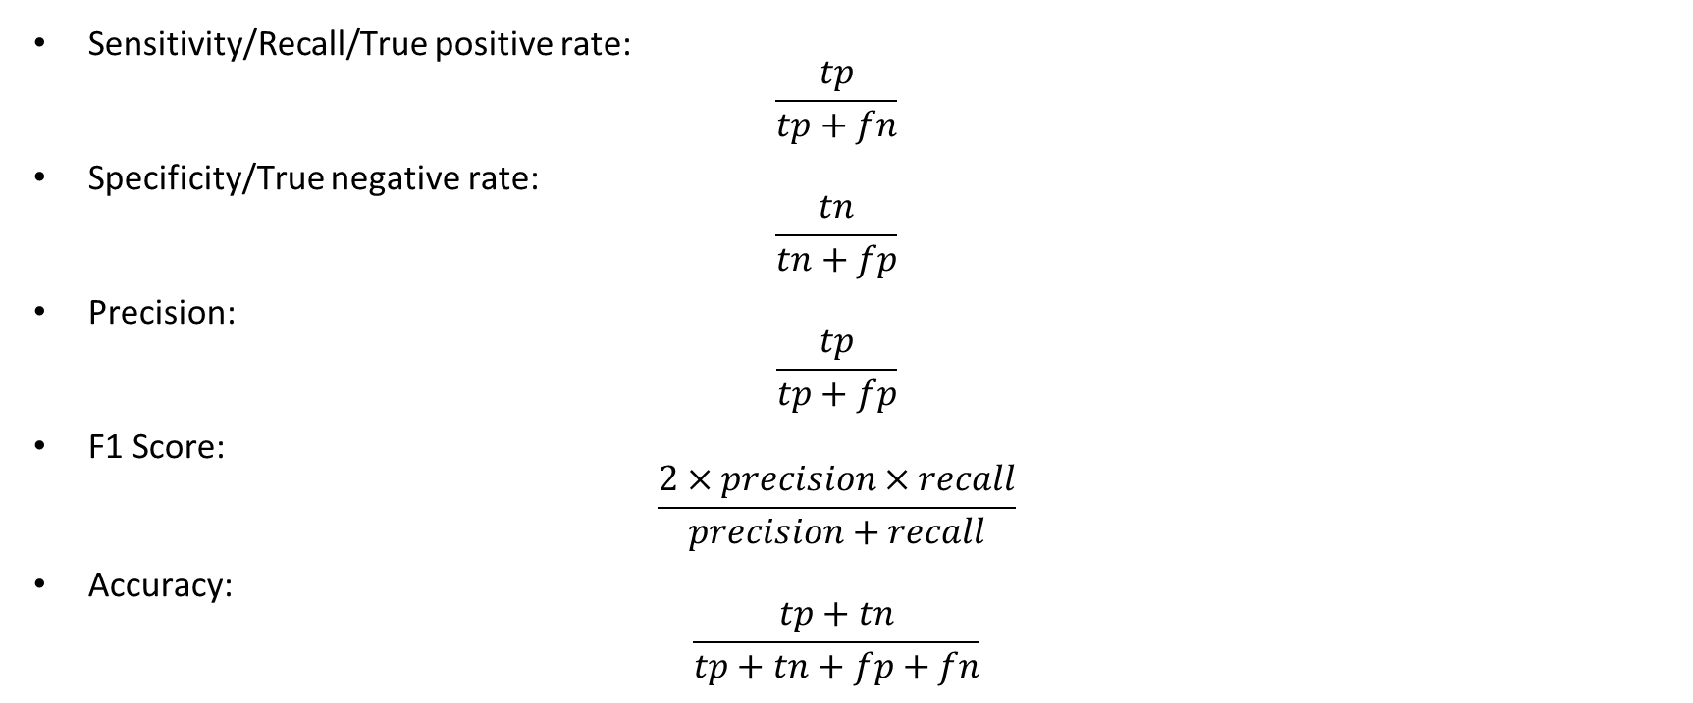
Classification Metrics

Slide 5
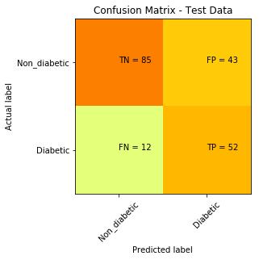
Classification metrics
For the given Confusion matrix, what is the F1 score?
65.4%

Slide 6
ROC and AUC
ROC (Receiver Operating Characteristics) is a probability curve with True positive rate in the vertical axis and False positive rate on the horizontal axis for different threshold values
AUC is the area under the ROC curve

Slide 7
Need for a Pipeline
Streamlines the process of transforming data, training an estimator and using it for prediction
Data
Pre-process(1)
Pre-process(2)
Model
predictions

Slide 8
Train, Validation and Test sets
It is a general practice to split our data into three sets
The train set
The data that we use to train the model
The validation set
The data that we use to ‘validate’ a model
Any hyper-parameter tuning that is done, is based on the performance of the model on the validation set
The test set
The data that is used to simulate real unseen data

Slide 9
Always tune the model based on the performance on the validation set, once the model is trained on the Train set
Never fine-tune a model based on its performance on the test set
Test set is meant to aid in assessing a model’s performance in production before the model hits production

Slide 10
Hyper-parameter tuning
As opposed to parameters (like the ones in linear regression slope and constant term) which change based on the data for a given parametric model, hyper-parameters are preset values even before a non-parametric model gets trained on the data
Parameters change during the training process
Hyper-parameters are preset and do not change while training
The process of setting the right hyper-parameters to get max performance out of a given model, is called Hyper-parameter Tuning

Slide 11
Grid Search and Random Search
Both are the two most common methods of choosing the right hyper-parameters
In Grid search, each and every combination of hyper-parameters tested before selecting the ‘best’ combination of hyper-parameters
In Random search, only a subset of combinations can be tested before selecting the ‘best’ combination of hyper-parameters
We use Random Search when the parameter grid is fairly large and we want to save on processing time
GridSearchCV and RandomizdSearchCV are included in the sklearn library to perform the same over a parameter grid, that is passed as an argument to the functions along with the estimator

Slide 12
Case study

Slide 13


Slide 14
Q and A

Slide 15


